Slide 1
MATEMATIKA U GRAMOFONSKIM PLOČAMA
Anđela Šantić i Bartol Gulam 3.A

Slide 2
OPĆENITO O PLOČAMA
-gramofoska ploča ili vinil je vrsta analogne pohrane zvuka
-nosač zvučnih informacija koje su sadržane na brazdama kao mikroskopski sitne izbočine i neravine
-igla prilikom reprodukcije titra u skladu s pretvorbom električnog napona u zvuk

Slide 3
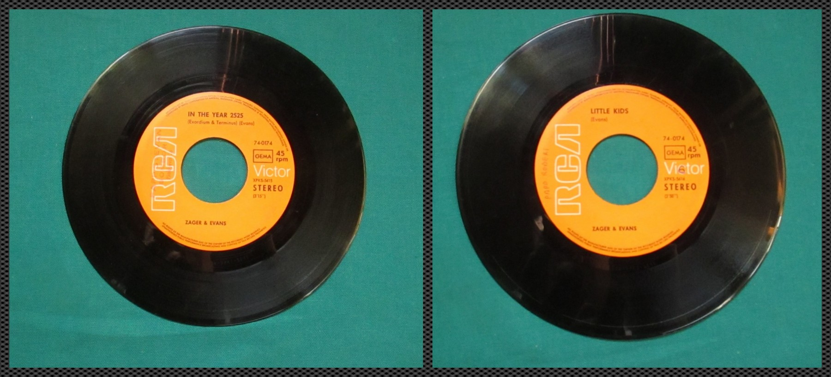
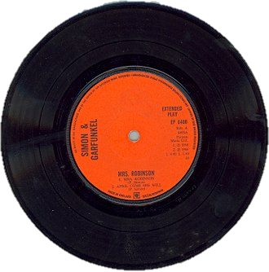
VRSTE PLOČA
LONG PLAY
-promjer->30 cm
-33 1/3 o/min
SINGL
-promjer->17,5 cm
-45 o/min
EXTENDED PLAY
-promjer->17,5 cm
-45 o/min

Slide 5
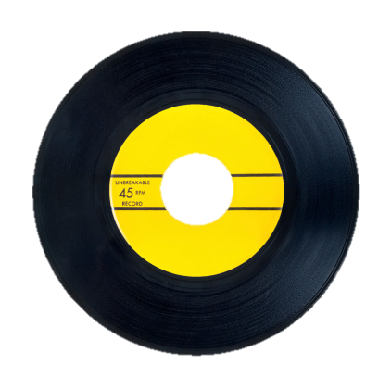
STALNI RADIJUSI
$$k_{1}$$
RADIJUSI NA 33 1/3 o/min:
$k_{1}$… $x^{2}+y^{2}=225$
$k_{2}$… $x^{2}+y^{2}=25$
RADIJUSI NA 45 o/min:
$k_{3}$… $x^{2}+y^{2}=76.5625$
$k_{4}$… $x^{2}+y^{2}=21.16$
$$k_{2}$$
$$k_{4}$$
$$k_{3}$$

Slide 6
RADIJUSI NA PRIMJERU
1973. Pink Floyd- „The Dark Side Of The Moon”
STRANA A
$k_{1}$… $x^{2}+y^{2}=210.25$
$k_{2}$… $x^{2}+y^{2}=196$
$k_{3}$… $x^{2}+y^{2}=166.41$
$k_{4}$… $x^{2}+y^{2}=132.25$
$k_{5}$… $x^{2}+y^{2}=73.96$

Slide 7
ŠTO SMO SVE RAČUNALI
DIRALIŠTA KRUŽNICE PLOČE I IGLE
TANGENTE VANJSKE I UNUTARNJE BRAZDE
KUT IZMEĐU PRAVACA POČETNE I ZAVRŠNE POZICIJE IGLE
KRUŽNE VIJENCE

Slide 8
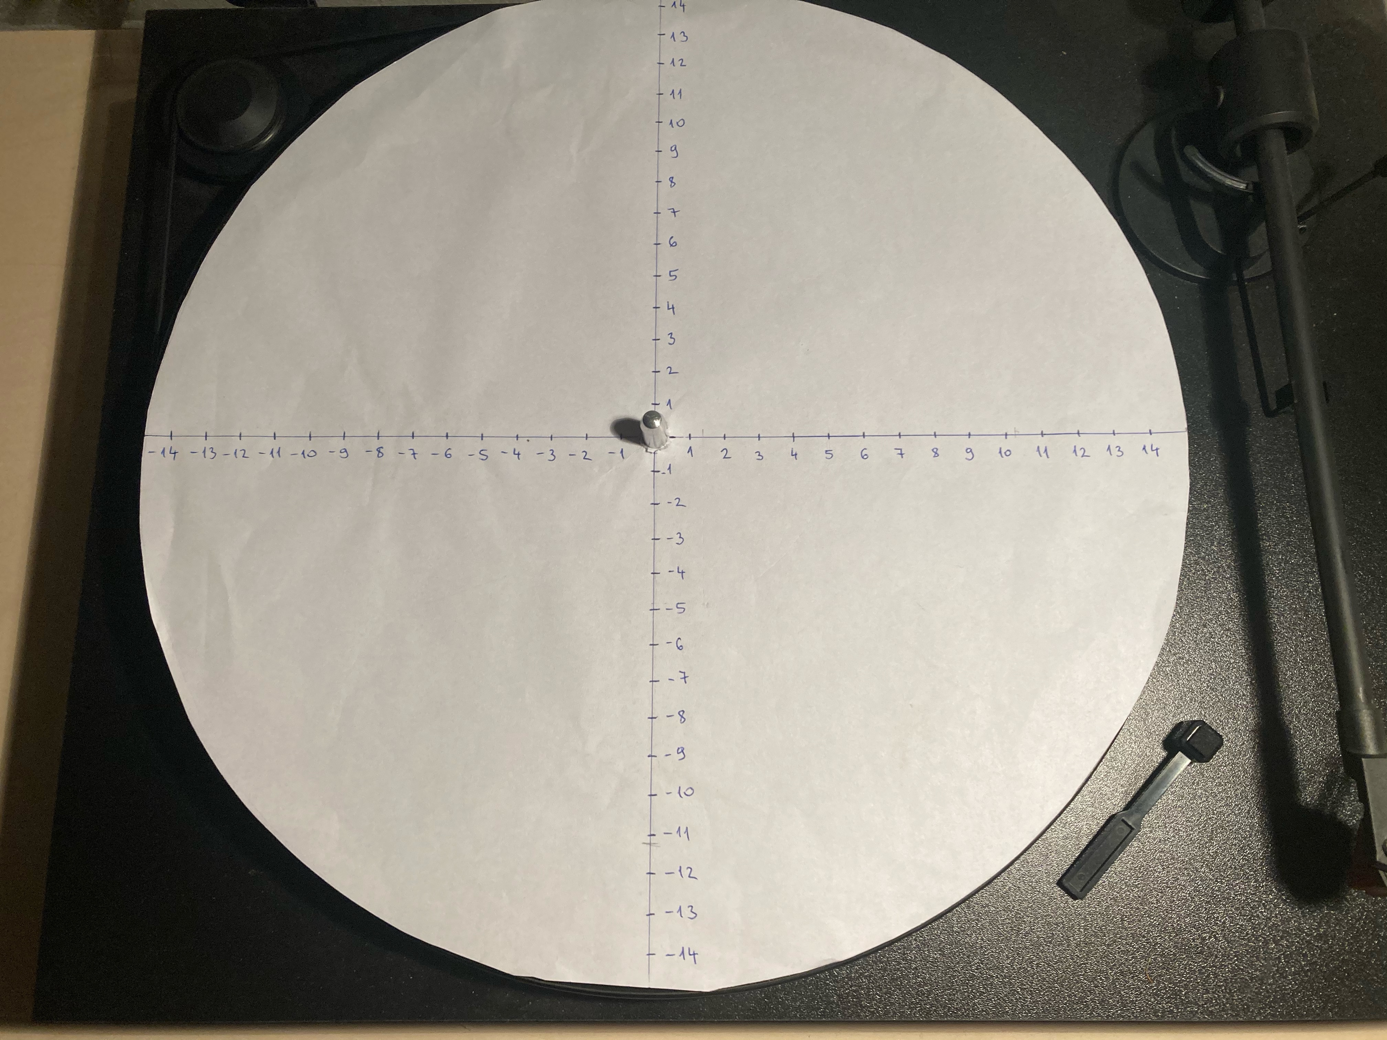
Si(18,10)

Slide 9
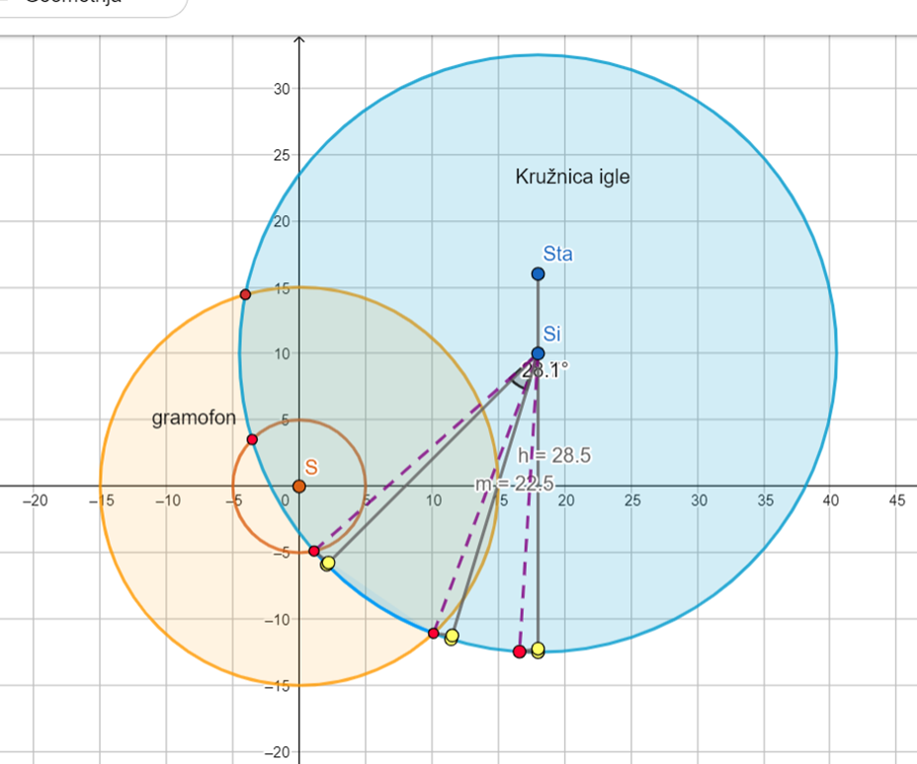

Slide 10
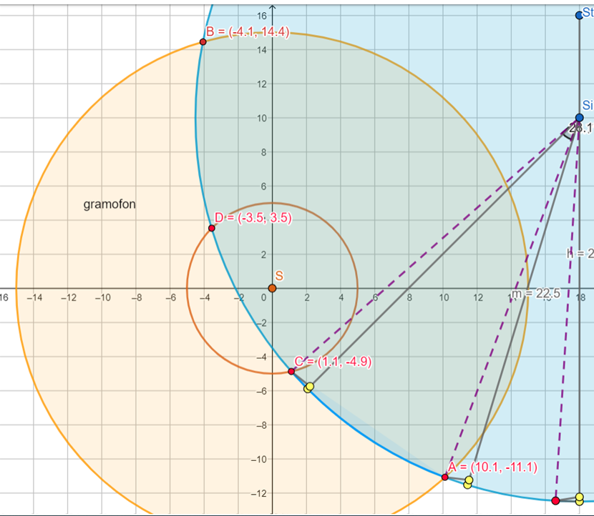
DIRALIŠTA KRUŽNICE PLOČE I IGLE(33 1/3)

Slide 11
DIRALIŠTA KRUŽNICE IGLE I PLOČE
$x^{2}+y^{2}=225$
${\left(x−18\right)}^{2}+{\left(y−10\right)}^{2}=506.25$
$x^{2}−36x+324+y^{2}−20y+100=506.25$
$x^{2}+y^{2}=36x−324+20y−100+506.25$
$36x−324+20y−100+506.25=225$
$36x+20y=225+324+100−506.25$
$36x−20y=142.75$
$20y=−36x+142.75$
$y=\frac{−9}{5}x+7.1375$
$x^{2}+{\left(\frac{−9}{5}x+7.1375\right)}^{2}=225$
$x^{2}+{\frac{81}{25}x}^{2}−25.695x+50.94391=225$
${\frac{106}{25}x}^{2}−25.695x−174.05609=0$
$x_{1,2}=\frac{25.695±60.10178}{\frac{212}{25}}$
$x_{1}=10.1 y_{1=}−11.0425$
$x_{2}=−4.0574 y_{2}=14.44$
A(10.1,-11.0425)
B(-4.0574,14.44)

Slide 12
DIRALIŠTA KRUŽNICE IGLE I PLOČE
$x^{2}+y^{2}=25$
${\left(x−18\right)}^{2}+{\left(y−10\right)}^{2}=506.25$
$x^{2}−36x+324+y^{2}−20y+100=506.25$
$x^{2}+y^{2}=36x−324+20y−100+506.25$
$36x−324+20y−100+506.25=25$
$36x+20y=25+324+100−506.25$
$36x+20y=−57.25$
$20y=−36x−57.25$
$y=\frac{−9}{5}x−2.8625$
$x^{2}+{\left(\frac{−9}{5}x−2.8625\right)}^{2}=25$
$x^{2}+{\frac{81}{25}x}^{2}+10.305x+8.19391=25$
${\frac{106}{25}x}^{2}+10.305x−16.80609=0$
$x_{1,2}=\frac{−10.305±19.77939}{\frac{212}{25}}$
$x_{1}=1.117 y_{1=}−4.8731$
$x_{2}=−3.548 y_{2}=3.5239$
C(1.117,-4.8731)
D(-3.548,3.5239)

Slide 13
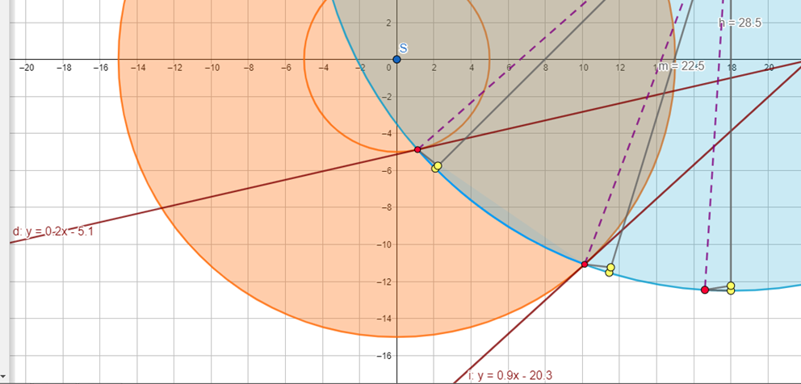
TANGENTE(33 1/3)

Slide 14
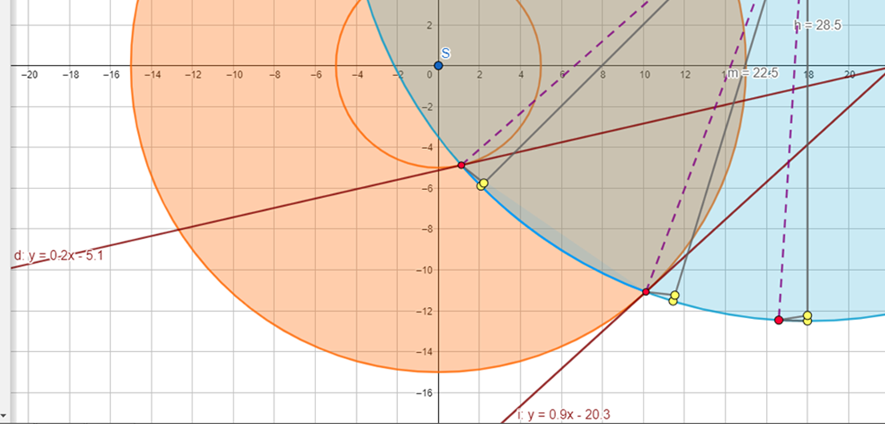
TANGENTE
TANGENTA VANJSKE BRAZDE
A(10.1,-11.0425) S(0,0) r=15
$\left(x_{1}−p\right)\left(x−p\right)+\left(y_{1}−q\right)\left(y−q\right)=r^{2}$
$\left(10.1−0\right)\left(x−0\right)+\left(−11.0425−0\right)\left(y−0\right)=225$
$10.1x−11.0425y=225$
$−11.0425y=10.1x+225$
$i…y=\frac{4040}{4417}x−20.37582$

Slide 15
TANGENTE
TANGENTA UNUTARNJE BRAZDE
C(1.117,-4.8731) S(0,0) r=5
$\left(x_{1}−p\right)\left(x−p\right)+\left(y_{1}−q\right)\left(y−q\right)=r^{2}$
$\left(1.117−0\right)\left(x−0\right)+\left(−4.8731−0\right)\left(y−0\right)=25$
$1.117x−4.8731y=25$
$−4.8731y=−1.117x+25$
$d…y=0.22922x−5.13020$

Slide 16
KUT IZMEĐU PRAVACA POČETNE I ZAVRŠNE POZICIJE IGLE
A(10.1,-11) Si(18,10)
$A∈p Si∈p,q$
$y−y_{1}=\frac{y_{2}−y_{1}}{x_{2}−x_{1}}\left(x−x_{1}\right)$
$y+11=\frac{10+11}{18−10.1}\left(x−10.1\right)$
$y+11=\frac{21}{7.9}\left(x−10.1\right)$
$y+11=\frac{210}{79}x−\frac{2121}{79}$
$p…y=\frac{210}{79}x−\frac{2990}{79}$
C(1.1,-4.9) Si(18,10)
$C∈q$ $Si∈q$
$y−y_{1}=\frac{y_{2}−y_{1}}{x_{2}−x_{1}}\left(x−x_{1}\right)$
$y+4.9=\frac{10+4.9}{18−1.1}\left(x−1.1\right)$
$y+4.9=\frac{14.9}{16.9}\left(x−1.1\right)$
$y+4.9=\frac{149}{169}x−\frac{1639}{1690}$
$q…y=\frac{149}{169}x−\frac{3321}{845}$

Slide 17
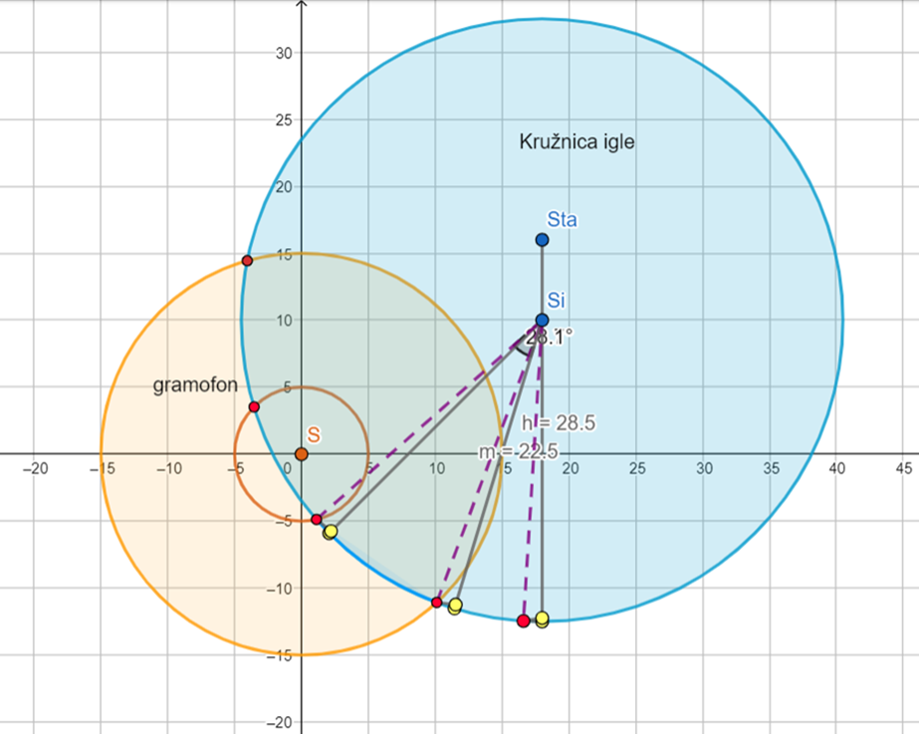
KUT IZMEĐU PRAVACA POČETNE I ZAVRŠNE POZICIJE IGLE
$k_{p}=\frac{210}{79}$ $k_{q}=\frac{149}{169}$
$tgφ=\left|\frac{k_{q}−k_{p}}{1+k_{q}k_{p}}\right|$
$tgφ=\left|\frac{\frac{149}{169}−\frac{210}{79}}{1+\frac{149}{169}∗\frac{210}{79}}\right|=\left|\frac{−1.77657}{3.34364}\right|=0.53133$
$φ=28°58′59"$

Slide 18
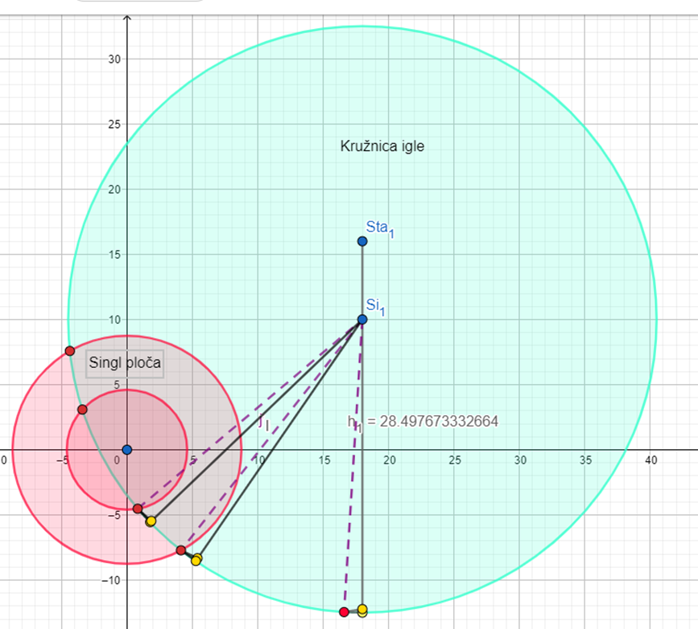

Slide 19
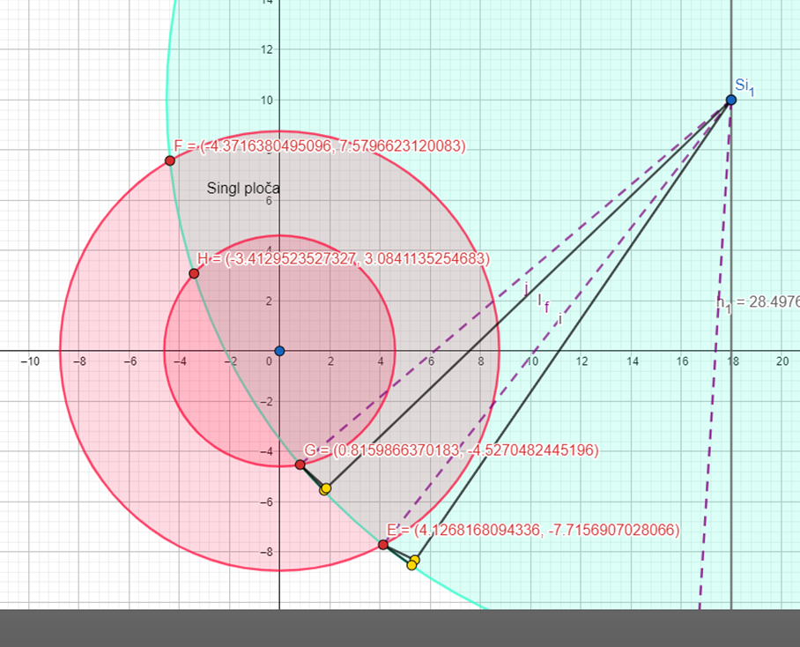
DIRALIŠTA KRUŽNICE IGLE I PLOČE(45)

Slide 20
DIRALIŠTA KRUŽNICE IGLE I PLOČE
$x^{2}+y^{2}=76.5625$
${\left(x−18\right)}^{2}+{\left(y−10\right)}^{2}=506.25$
$x^{2}−36x+324+y^{2}−20y+100=506.25$
$x^{2}+y^{2}=36x−324+20y−100+506.25$
$36x−324+20y−100+506.25=76.5625$
$36x+20y=324+100−506.25+76.5625$
$36x+20y=\frac{−91}{16}$
$20y=−36x−\frac{91}{16}$
$y=\frac{−9}{5}x−\frac{91}{320}$
$x^{2}+{(\frac{−9}{5}x−\frac{91}{320})}^{2}=76.5625$
$x^{2}+\frac{81}{25}x^{2}+\frac{819}{800}x+\frac{8281}{102400}=76.5625$
$\frac{106}{25}x^{2}+\frac{819}{800}x−76.48163=0$
$x_{1,2}=\frac{−\frac{819}{800}±\sqrt{{(\frac{819}{800})}^{2}−4×\frac{106}{25}×(−76.48163)}}{\frac{212}{25}}$
$x_{1,2}=\frac{\frac{−819}{800}±36.03022}{\frac{212}{25}}$
$x_{1}=4.12812$ ${ y}_{1}=−7.714991$
$x_{2}=−4.36957$ $y_{2}=7.580851$
E(4.12812,-7.714991)
F(-4.36957,7.580851)

Slide 21
DIRALIŠTA KRUŽNICE IGLE I PLOČE
$x^{2}+y^{2}=21.16$
${\left(x−18\right)}^{2}+{\left(y−10\right)}^{2}=506.25$
$x^{2}−36x+324+y^{2}−20y+100=506.25$
$x^{2}+y^{2}=36x−324+20y−100+506.25$
$36x−324+20y−100+506.25=21.16$
$36x+20y=324+100−506.25+21.16$
$36x+20y=\frac{−6109}{100}$
$20y=−36x−\frac{6109}{100}$
$y=\frac{−9}{5}x−\frac{6109}{2000}$
$x^{2}+{(\frac{−9}{5}x−\frac{6109}{2000})}^{2}=21.16$
$x^{2}+\frac{81}{25}x^{2}+10.9962x+9.32997=21.16$
$\frac{106}{25}x^{2}+10.9962x−11.83003=0$
$x_{1,2}=\frac{−10.9962±\sqrt{{10.9962}^{2}−4∗\frac{106}{25}∗(−11.83003)}}{\frac{212}{25}}$
$x_{1,2}=\frac{−10.9962±17.93192}{\frac{212}{25}}$
$x_{1}=0.81789$ $y_{1}=−4.526702$
$x_{2}=−3.41133 { y}_{2}=3.085894$
G(0.81789,-4.525702)
H(-3.41133,3.085894)

Slide 22
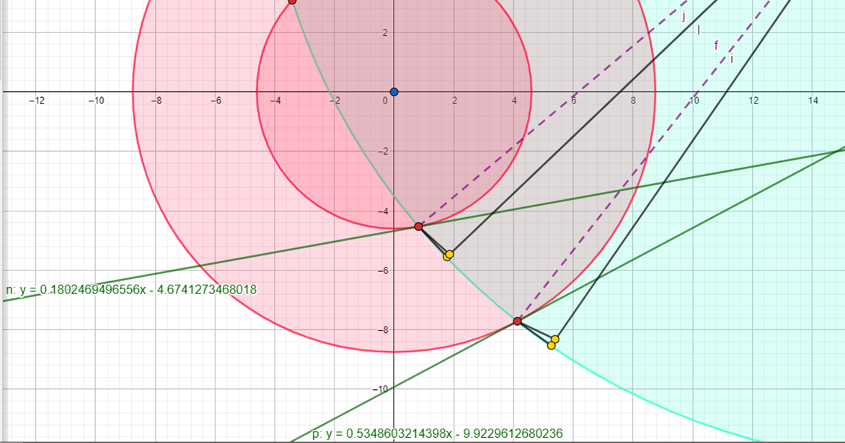
TANGENTE(45)

Slide 23
TANGENTE
TANGENTA VANJSKE BRAZDE
E(4.12812,-7.714991) S(0,0) r=15
$\left(x_{1}−p\right)\left(x−p\right)+\left(y_{1}−q\right)\left(y−q\right)=r^{2}$
$\left(4.12812−0\right)\left(x−0\right)+\left(−7.714991−0\right)\left(y−0\right)=225$
$4.12812x−7.714991y=225$
$−7.714991y=−4.12812x+225$
$p…y=0.53508x−29.164$

Slide 24
TANGENTE
TANGENTA UNUTARNJE BRAZDE
G(0.81789,-4.526702) S(0,0) r=5
$\left(x_{1}−p\right)\left(x−p\right)+\left(y_{1}−q\right)\left(y−q\right)=r^{2}$
$\left(0.81789−0\right)\left(x−0\right)+\left(−4.526702−0\right)\left(y−0\right)=25$
$0.81789x−4.526702y=25$
$−4.526702y=−0.81789x+25$
$n…y=0.18068x−5.52278$

Slide 25
KUT IZMEĐU PRAVACA POČETNE I ZAVRŠNE POZICIJE IGLE
E(4.12812,-7.714991) Si(18,10)
$E∈p Si∈p$
$y−y_{1}=\frac{y_{2}−y_{1}}{x_{2}−x_{1}}\left(x−x_{1}\right)$
$y+7.714991=\frac{10+7.714991}{18−4.12812}\left(x−4.12812\right)$
$y+7.714991=1.27704x−5.27177$
$p…y=1.27704x−12.986761$
G(0.81789,-4.526702) Si(18,10)
$G∈q Si∈q$
$y−y_{1}=\frac{y_{2}−y_{1}}{x_{2}−x_{1}}\left(x−x_{1}\right)$
$y+4.526702=\frac{10+4.526702}{18−0.81789}\left(x−0.81789\right)$
$y+4.526702=0.84546x−0.69149$
$q…y=0.84546x−5.218192$

Slide 26
KUT IZMEĐU PRAVACA POČETNE I ZAVRŠNE POZICIJE IGLE
$k_{p}=1.27704$ $k_{q}=0.84546x$
$tgφ=\left|\frac{k_{q}−k_{p}}{1+k_{q}k_{p}}\right|$
$tgφ=\left|\frac{0.84546−1.27704}{1+0.84546∗1.27704}\right|=\left|\frac{−0.43158}{2.07969}\right|=0.20752$
$φ=11°43′25"$

Slide 27
KRUŽNI VIJENCI
33 $\frac{1}{3}$
$r_{1}=15$ $P_{1}=r^{2}π=225{πcm}^{2}$
$r_{2}=14.4$ $P_{2}=r^{2}π=207.36π{cm}^{2}$
$r_{3}=5$ $P_{3}=r^{2}π=25π{cm}^{2}$
$P_{k1}=225π−207.36π=17.64π{cm}^{2}$
$P_{k2}=225π−25π=200π{cm}^{2}$
45
$r_{1}=8.75$ $P_{1}=r^{2}π=\frac{1225}{16}π{cm}^{2}$
$r_{2}=8.4$ $P_{2}=r^{2}π=70.56π{cm}^{2}$
$r_{3}=4.6$ $P_{3}=r^{2}π=21.16π{cm}^{2}$
$P_{k1}=\frac{1225}{16}π−70.56π=\frac{2401}{400}π{cm}^{2}$
$P_{k2}=\frac{1225}{16}π−21.16π=55.4025π{cm}^{2}$

Slide 28
BRZINE
-malo fizike
-približavanjem igle prema središtu linearne brzina se smanjuje
Primjer: The Dark Side Of The Moon
Money -> $v=6,122∗{10}^{−5} cm/s$
ova pjesma nalazi se na početku strane B
The Great Gig In The Sky-> $v=5,98∗{10}^{−5}cm/s$
ova pjesma nalazi se na kraju strane A

Slide 29
BRZINE
33$\frac{1}{3}$
$f=33\frac{1}{3} \frac{R}{min}=0,55556\frac{R}{s}$
$ω=2πf=2π×0.55556=3.49066 cm/s$
$v_{v}=ω∗r_{v}=3.49066∗15=52.35988 cm/s$
$v_{m}=ω∗r_{m}=3.49066∗5=17.4533 cm/s$
45
$f=45 \frac{R}{min}=0,75\frac{R}{s}$
$ω=2πf=2π×0.75=4.71239 cm/s$
$v_{v}=ω∗r_{v}=4.71239∗15=70.68585 cm/s$
$v_{m}=ω∗r_{m}=4.71239∗5=23.56195 cm/s$
FREKVENCIJA
KUTNA BRZINA
LINEARNE BRZINE

Slide 30
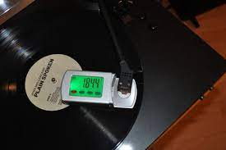
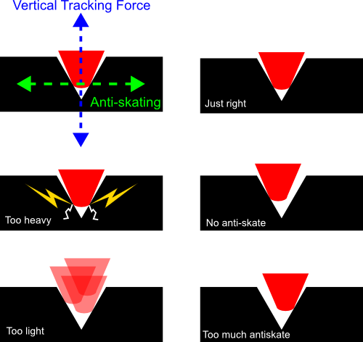
SILE
sila na gramofonu odnosi se na način na koji igla pritišče ploču prilikom sviranja glazbe
svrha sile je određivanje količine težine kojom igla stoji na ploči
antiskating force je još jedna sila prisutna na gramofonu
ona održava jednaku silu na unutarnjoj i vanjskoj strani igle da bi bila stabilana unutar brazde

Slide 31
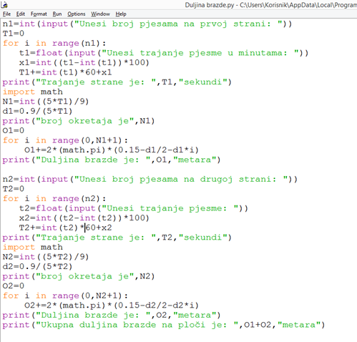
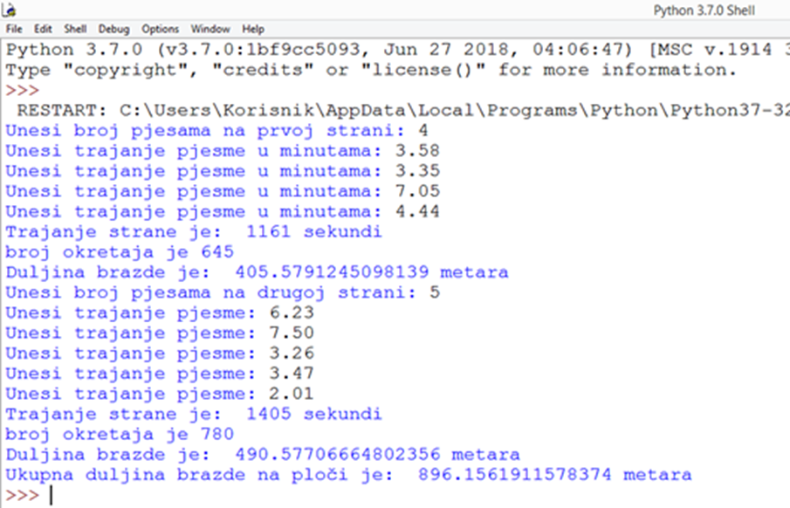
DULJINA BRAZDE

Slide 32
TRETMAN ZA AUDIOFILE
kako bi proizvedena glazba bila savršena bitno je namjestiti idealnu težinu kojom igla pritišće ploču
kada su sile namještene idealno pravac koji prolazi kroz iglu je tangenta na brazdu kroz koju prolazi
linearna brzina se smanjuje prema kraju ploče zbog toga što se smanjuje radijus pa se tako smanjuje i kvaliteta zvuka
pa tako postoje neke ploče koje imaju radijus 15 cm (veličine kao 33 1/3), ali se vrte brzinom 45 o/min

Slide 33
IZVORI
https://en.wikipedia.org/wiki/LP_record
https://math.stackexchange.com/questions/2805803/estimating-the-length-of-the-groove-on-an-lp
http://www.undr.com/understatement/2012/the-math-behind-why-compact-discs-sound-better-than-vinyl-records/
https://victrola.com/blogs/articles/how-do-vinyl-records-work
https://cen.acs.org/articles/94/i24/Groovy-chemistry-materials-science-behind.html
https://mathforums.com/threads/a-problem-involving-a-vinyl-record.49674/
https://flypaper.soundfly.com/produce/vinyl-how-it-works-and-what-that-means-for-you/
https://audio-advent.ghost.io/how-does-a-vinyl-record-work/
https://www.britannica.com/technology/LP-record
https://www.londonsoundacademy.com/blog/how-does-vinyl-work

Slide 34
HVALA NA PAŽNJI ANĐELA ŠANTIĆ I BARTOL GULAM 3.A

